Slide 1
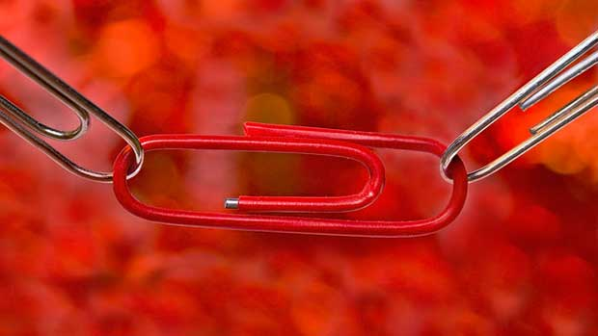
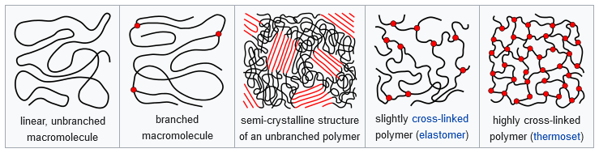
Polymers – Condensation polymers

Slide 2
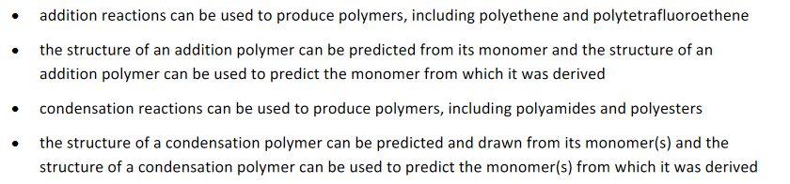
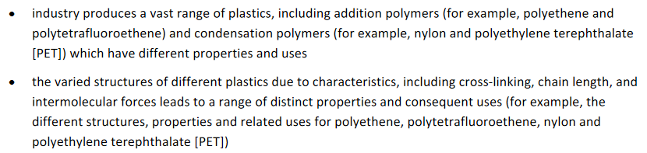
SCSA outline

Slide 3
Condensation polymers
This involves a reaction between two different functional groups in which a small molecule is eliminated (usually water) and the two functional groups link together
Usually involves two different monomers, each a di-functional group (two groups per molecule) but can have a single monomer if each molecule contains both functional groups required to polymerise
Two common types of condensation polymerisation are:
  Polyesters
  Polyamides

Slide 4
Condensation polymers
Both reaction types involve two functional groups
For polyester
  a carboxylic acid and an alcohol
For polyamide
  a carboxylic acid and an amine
When using two monomers they would be di-oic acid and the other group need to be di-ol or di-amine

Slide 5
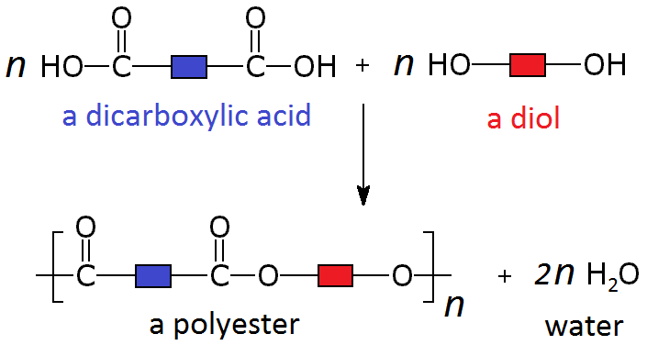
Polyesters
Are made by the reaction between a carbocylic acid group and an alcohol group.
When using two monomers they would be di-oic acid and the other group need to be di-ol
The esterification reaction eliminates water

Slide 6

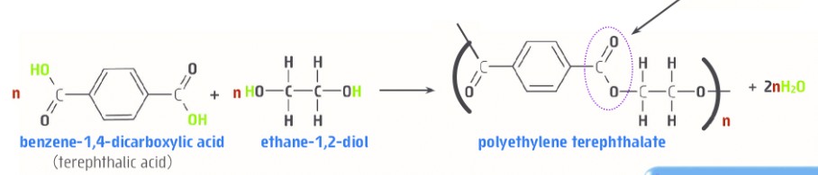
Polyethylene terephthalate (PET)
PET have a permanent dipole around the ester group
When aligned they can interact through dipole-dipole and dispersion IMF
High degree of crystallinity (very ordered structure), makes them very strong and tough
Good chemical resistance, strength and good gas barrier properties make them useful as soft drink bottles
Can be re-melted to make fibres that can be used in carpets and clothing

Slide 7
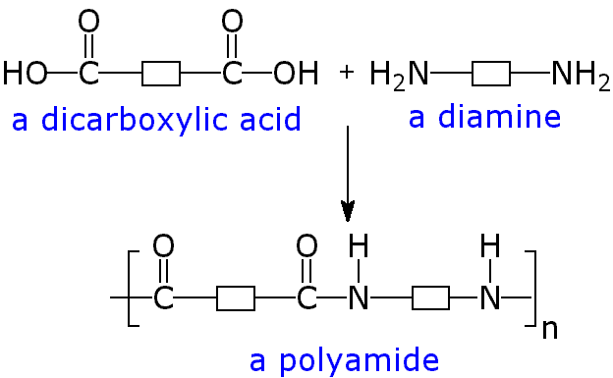
Polyamides
Are made by the reaction between a carbocylic acid group and an amine group.
When using two monomers they would be di-oic acid and the other group need to be di-amine
The polyamide reaction eliminates water

Slide 8
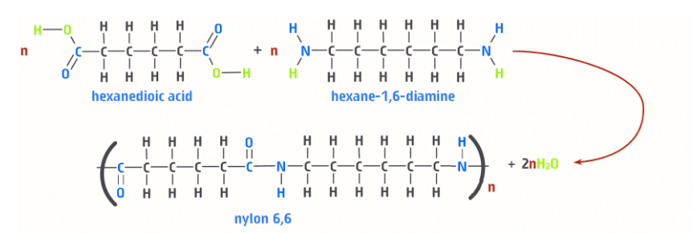
Nylon
The 6,6 refers to the number of carbon atoms in each of the monomers. Also have nylon 4,6; nylon 6,10 and nylon 6,12.
Ability to form hydrogen bonds between lone pair electrons of the carbonyl group the hydrogen of the N-H group
Increases tensile strength and stiffness

Slide 9
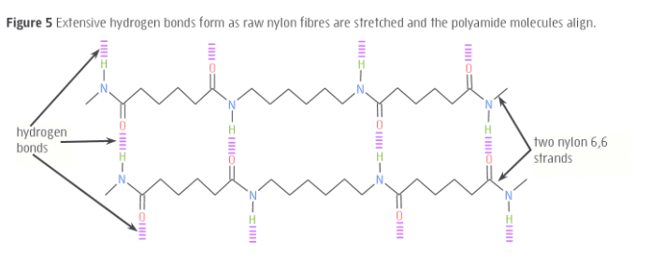
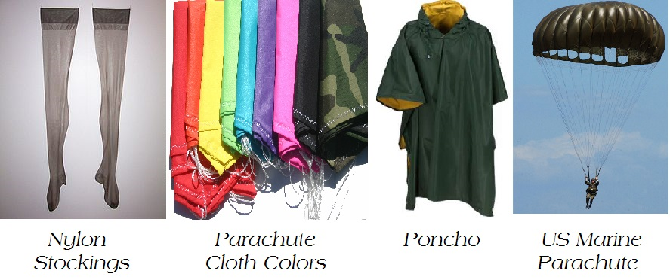
Nylon

Slide 10
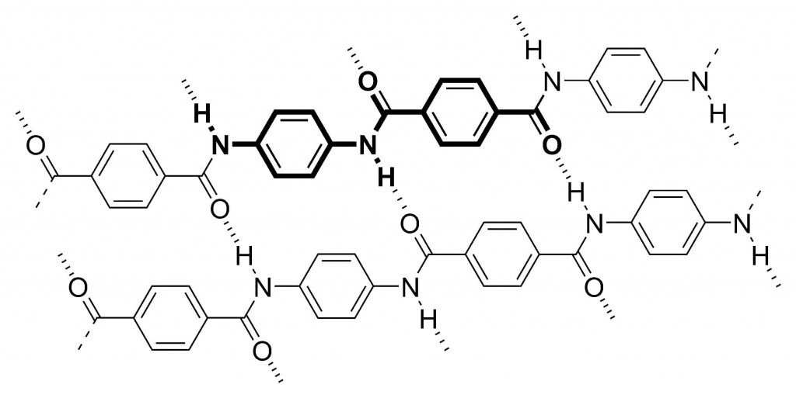
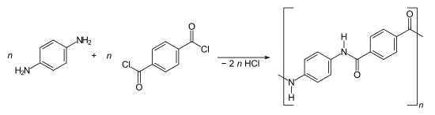

Other condensation polymers
Kevlar
  A polyamide using monomers with aromatic rings.
  Can be synthesised from the following reaction:
  Very strong when used as a fabric as polymers can lie parallel with each other and form regular hydrogen bonds down the length

Slide 11
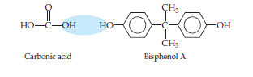
Condensation polymers
Lexan, a polycarbonate, is a condensation polymer formed between carbonic acid and biphenol A. Draw a section of the polymer showing 3 repeating sections.

Slide 12
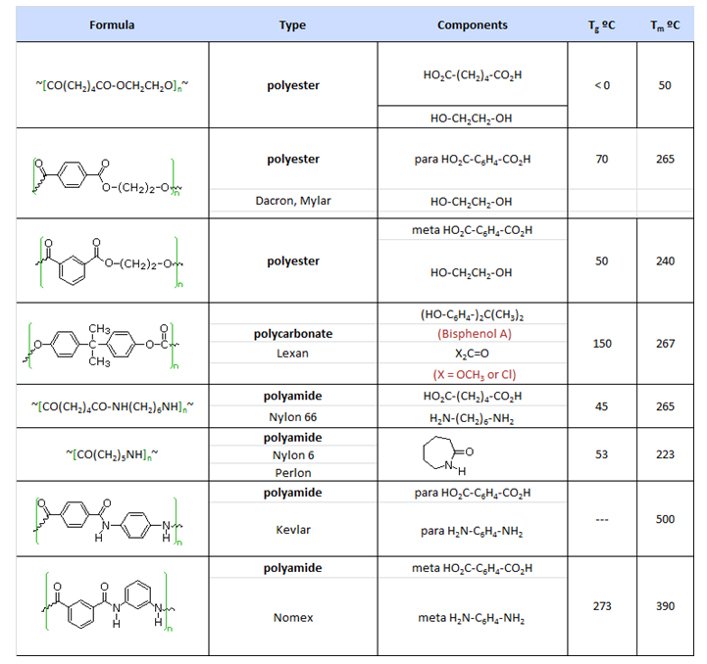
Condensation polymers

Slide 13
Effect of cross-linking
Cross-link is a bond that links one polymer chain to another
Cross-linking is typically done to change the polymers’ physical properties.
A small amount of cross-linking increases viscosities as the polymer melts, increases the amount of cross-linking gives the material elastometeric properties (stretch the polymer but on releasing the force they return to their original shape). Very high cross-linking makes very rigid or glassy materials (such as rubber bouncy balls!).
Cross-linked polymers result in thermosetting material (cannot be melted or reshaped) making them very difficult to recycle

Slide 14
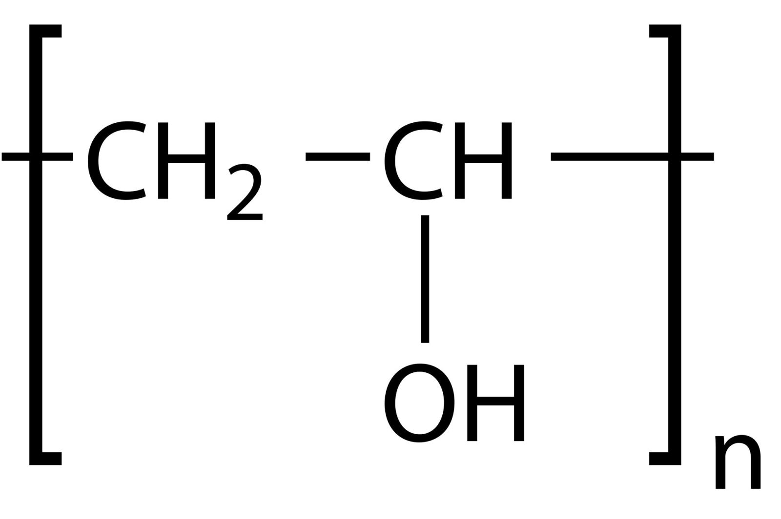
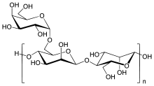
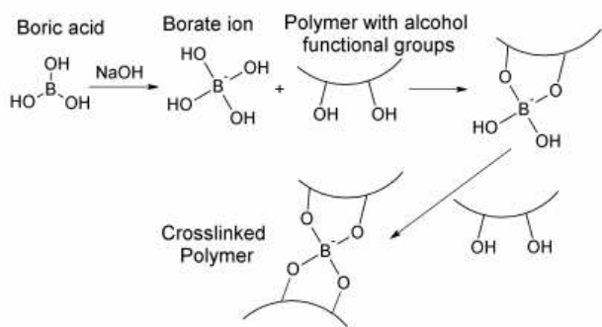
Making slime through cross-linking polymers
Polyvinylalcohole (PVA, synthetic polymer)
Guar gum (a natural, polysaccharide polymer)
We use boric acid to create cross-links in polymers that have –OH groups.

Slide 15
